Slide 1

FYP
Proposal
Maid In
Inam Ullah (CS191086)
Faisal Zaman Haider (CS182013)
Poorab Gangwani (CS191092)
Supervisor: Arifa Mustafa
Co-Supervisor: Huma Jamshed
FALL 2022
DHA Suffa University

Slide 2

Summary
Problem Statement
Business Objectives
Project Scope
Literature Review
Project methodology
Project Plan (Time lines)
Budget / Costing (if any)
Project tools (or H/W required)
FYP Deliverables
References

Slide 3
Group Introduction
Inam Ullah
Faisal Zaman Haider
Poorab Gangwani
Arifa Mustafa
Chosen for her knowledge and expertise in development which serves as the domain for the proposed product

Slide 4
1- Problem Statement
Problem | Many service industries in Pakistan have seen great shift to digitalization and utilization of online platforms to increase accessibility and productivity for its customers. Domestic service industry has mostly been neglected in such treatment and still adheres to old inadequate practices for providing service opportunities which renders it a very time-intensive and undesirable process. There are no recognizable online platforms for connecting people of the domestic service industry and for promoting awareness in regards to availability of suitable and affordable services
Affects | Domestic service serves as a source of subsistence and survival to a large chunk of the populace in Pakistan and is virtually required in every household for management and control but due to the aforementioned problems they face difficulty in gaining access to and obtaining services that suite their needs
Impacts | Due to the lack of technological advances in the industry, hardship is unnecessarily incurred by both domestic workers and people seeking their service as they are very much restricted to primitive and manual methods for getting the know-how of the different prospects available out there for them like personal enquires, 3rd party agencies etc. all of which make the process burdening and inefficient for them. T
Solution | An online mobile platform equipped with many modern tools and facilities replacing the primitive ways of approaching domestic service employment for both customer and domestic worker, allowing online conducting of business transaction, interactive communication, and improving the overall experience for both

Slide 5
1- Problem Statement
FYP Objectives:
To provide domestic workers with a platform that gives them insight and opportunity pertaining to potentially open work requiring their specific expertise.
To provide online platform for negotiation between customer and hired help to overall strengthen work process by establishing mutually agreed upon work elements such as work hours, status, task etc.
To provide domestic service patrons with the ability to reach out to reams of prospective domestic workers quickly and easily
To provide technological structure to domestic service industry

Slide 6
2- Business Objectives
allow online monetary transactions between customers and domestic service agents
Increase and streamline communication between customers and domestic service agents
Increase business for domestic service agents
Privy domestic service agents to all the available service opportunities around them
Connect customers to suitable domestic service agents with expedition

Slide 7
3- Project Scope
In Scope:
Varied collection of domestic services to choose from and autonomy to decide preferred help
Different channels of communications namely chatting and voice calling.
Registration and Secure data storage of personal information through registration
Authentication and verification of user through Login system
Login System
Terms and conditions module
Service deadline countdown timer
System for management of online monetary transactions
Aiding and search and filter of potential house help through parameters such as price range, location, work duration
Profile creation and maintenance

Slide 8
3- Project Scope
Location tracking functionality for users
source location selection option for customer
extension options for in-progress service transactions
language options between Urdu and English
Ratings and Feedback system
Service broadcast options
Transaction history module
Settings module
Contact us module
Service termination capability for customer
Service termination request capability for service provider
Editing capability towards content personally inputted into the application

Slide 9
3- Project Scope
Out Scope:
Built-in training tutorial or guidance to familiar with the interconnected functioning of the application components
Facility for conveying personal grievances and issues towards application performance or functions
Digital Wallet system
Options for live-in, part time and regular service
Pop-up advertisements

Slide 10
4- Literature Review
Author | Year | Paper Name | Technique | Result
Sheetal bandekar, D Avril | 2016 | Domestic Android Application for Home Service | Use of GPS to pinpoint and assign closest service provider to the service request with the aid of personal latitude and longitude algorithm | A domestic service application automatically assigning servicemen based on your need and location with no verbal communication or online payment facilities
Sharada kori Sudha ayatti Ashish kumar Akshay kurabar | 2017 | Android Application on Domestic Services - eSeva | Use of GPS to map out customer location and advertise service request of customer to respective servicemen of choice | A domestic service application utilizing GPS technology and with no chat or verbal communication features nor payment system

Slide 11
4- Literature Review
Author | Year | Paper Name | Technique | Result
Naeem Ahmed Khan | 2020 | Development of App to provide blue collar services to the public | Using mobile apps and GPS to allow customers access to variety of blue collar workers suited to their need | A mobile domestic service application allowing communication and transaction between customers and blue collar workers but with no map technology nor online payment system

Slide 12
5- Project Methodology
Project Approach (Waterfall/Agile etc) :
The software development methodology to be utilized in the development of the application will be the traditional waterfall approach where the whole sequential process will constitute the following:

Slide 13
5- Project Methodology
Step 01: Requirement gathering and analysis
We will understand, gather and assimilate the necessary tools and information to be used and prepare appropriate documentation pertaining to the application and its components
Step 02: Design
Based on the knowledge we will have derived from the requirements documentation, we will further create and structure specific designs such as ERDs, Use Cases, flow diagrams etc.
Step 03: Implementation
We will collectively and individually develop the planned out modules, units and components with proper coordination and synchronization.
Step 04: Testing
We will formally prepare test cases and protocols to apply to the application after the conclusion of its development process for further validation.

Slide 14
5- Project Methodology
Team Role & responsibilities:
Name | Roles | Responsibilities
Inam Ullah | Team Lead | Proposal Requirement gathering Design Frontend Backend Database Testing
Faisal Zaman Haider | Member 1 | Proposal Requirement gathering Design Frontend Backend Database Testing

Slide 15
5- Project Methodology
Team Role & responsibilities:
Name | Roles | Responsibilities
Poorab Gangwani | Member 2 | Proposal Requirement gathering Design Frontend Backend Database Testing

Slide 16
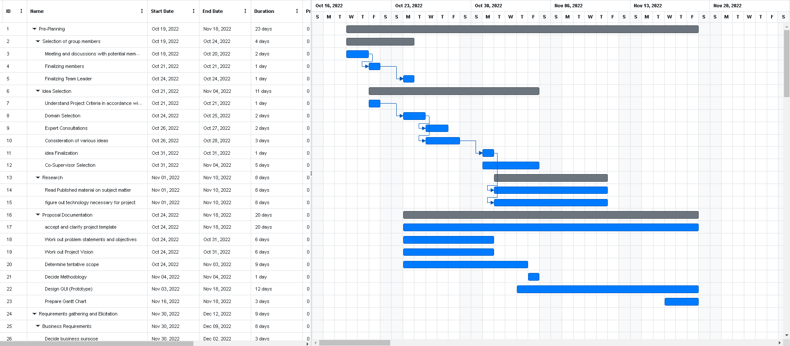
6- Project Plan
Gantt Chart

Slide 17
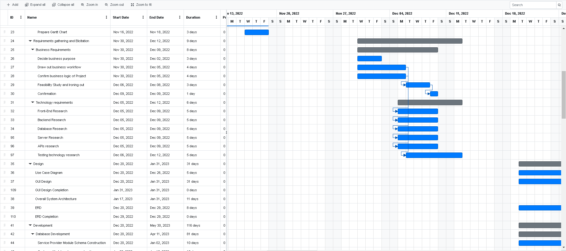
6- Project Plan
Gantt Chart

Slide 18
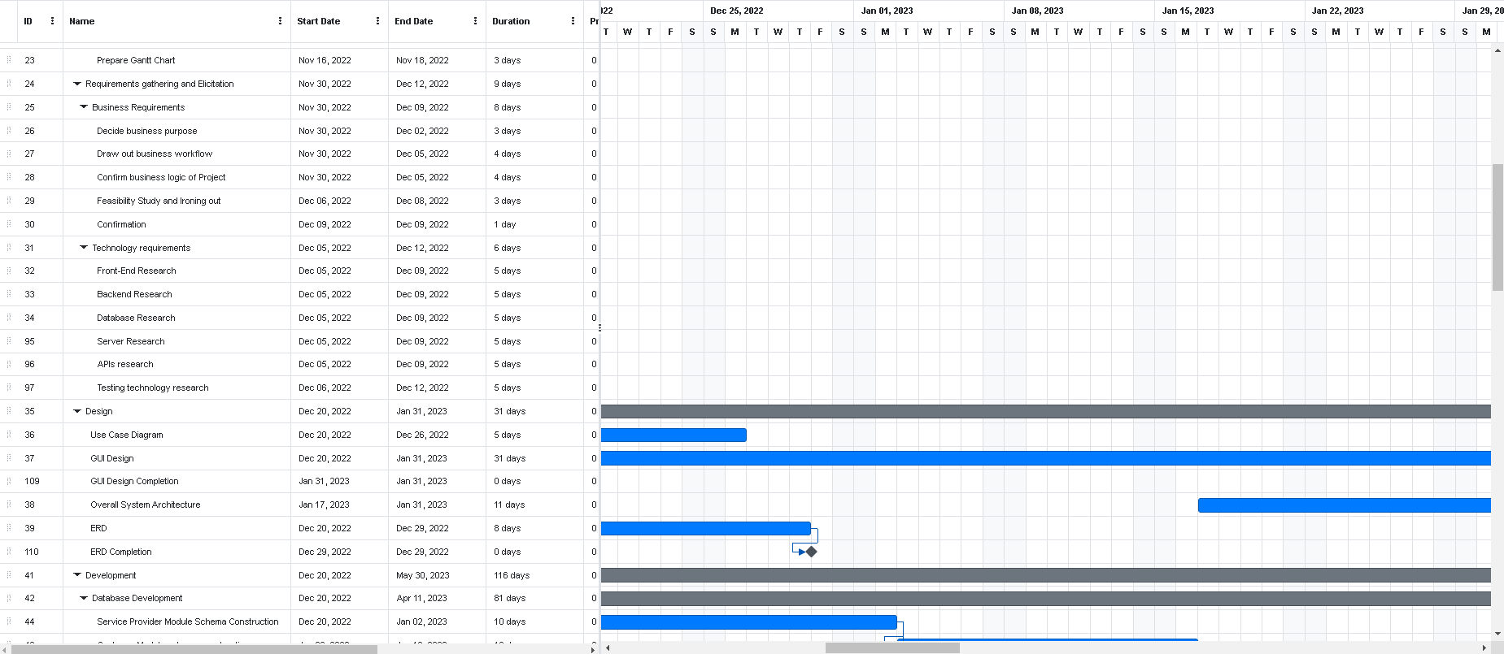
Project Plan
Gantt Chart

Slide 19
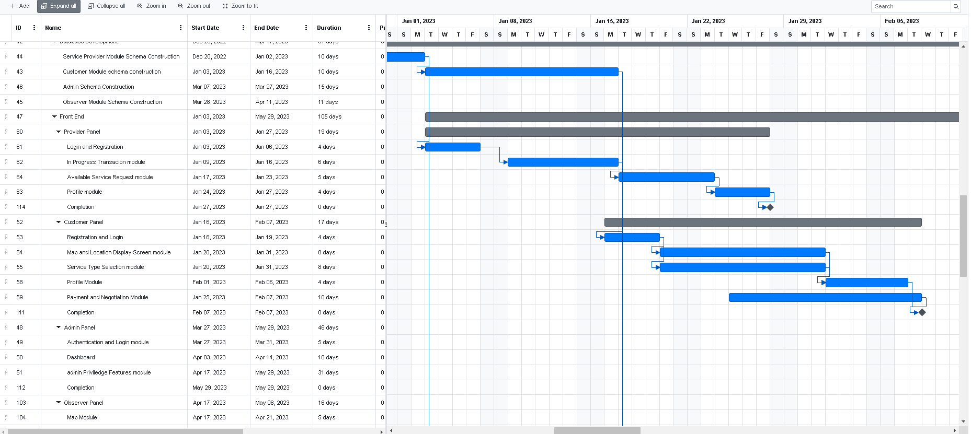
Project Plan
Gantt Chart

Slide 20
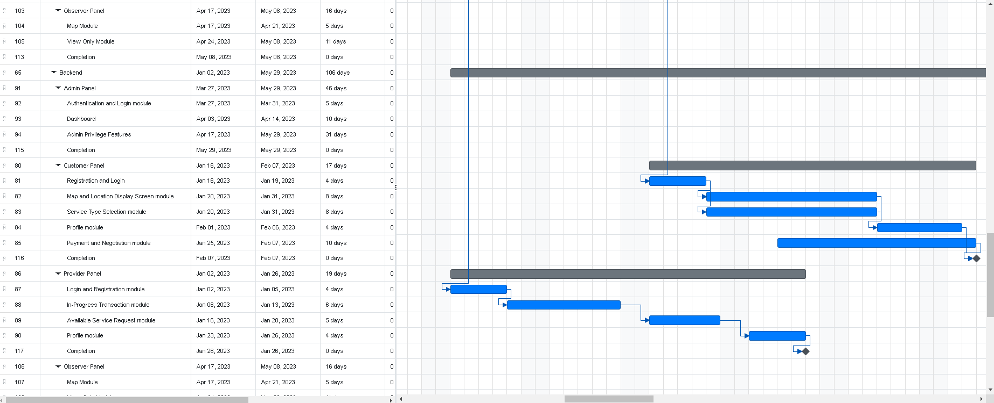
Project Plan
Gantt Chart

Slide 21
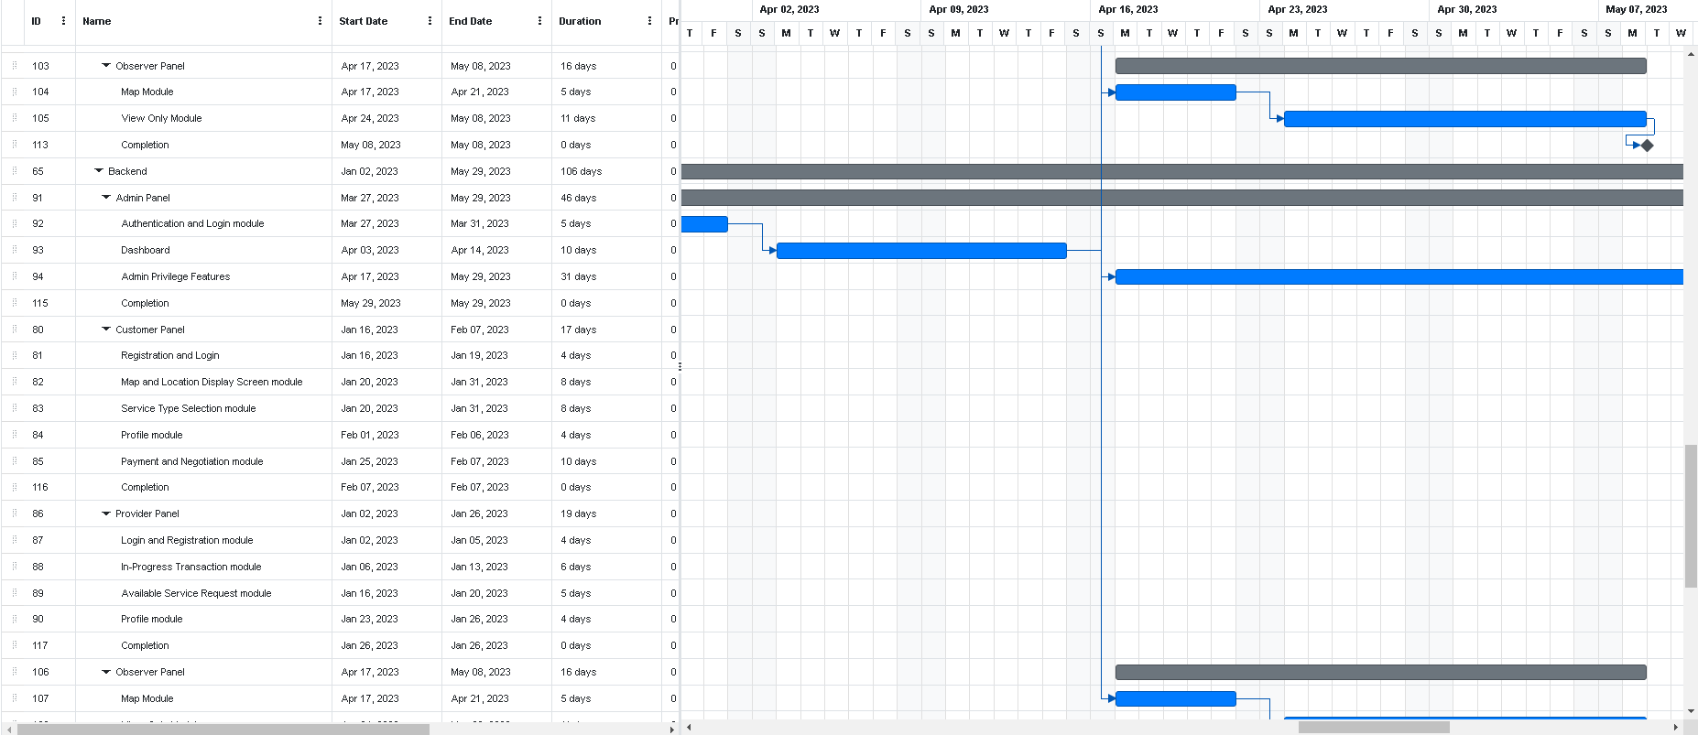
Project Plan
Gantt Chart

Slide 22
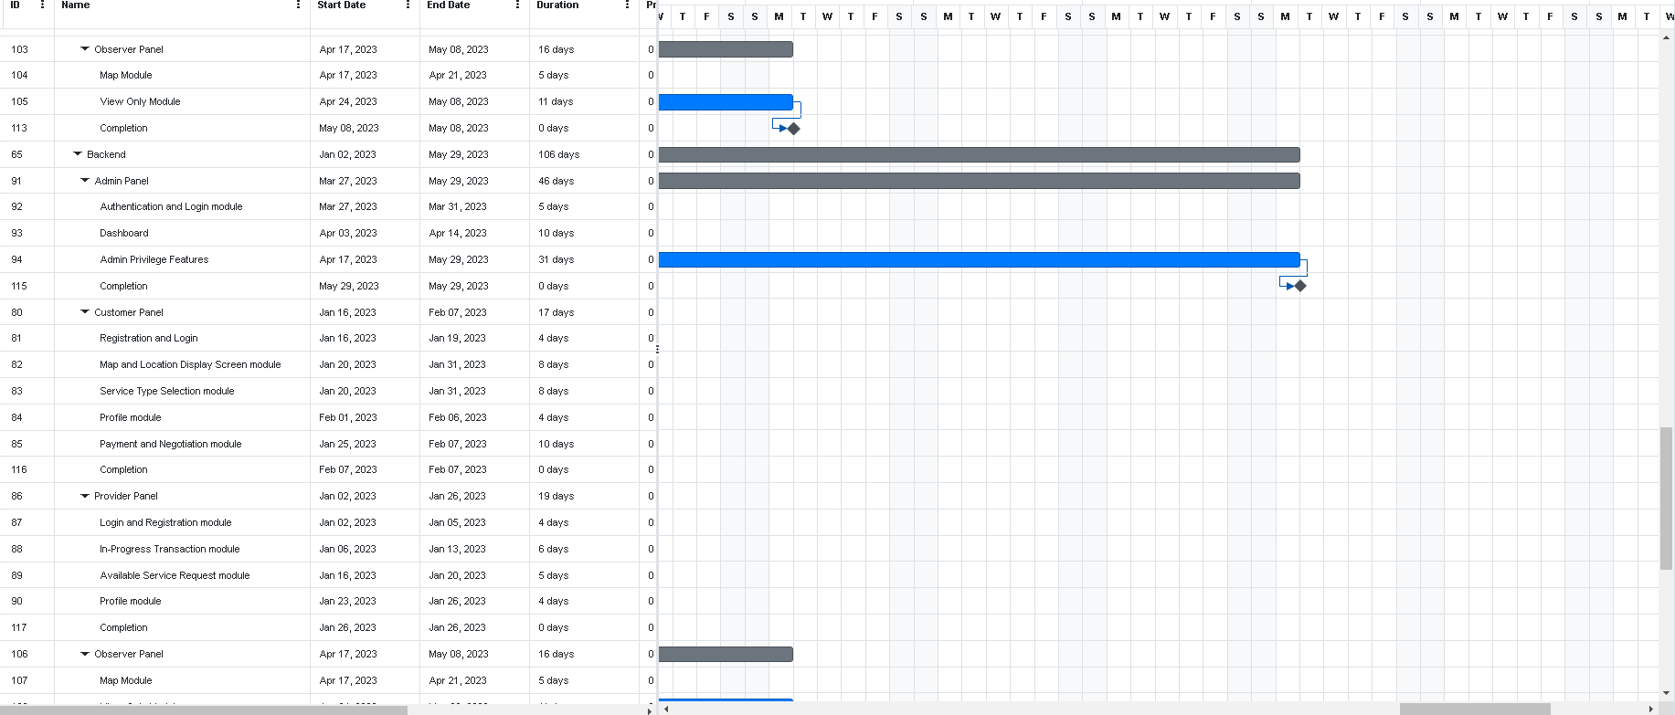
Project Plan
Gantt Chart

Slide 23
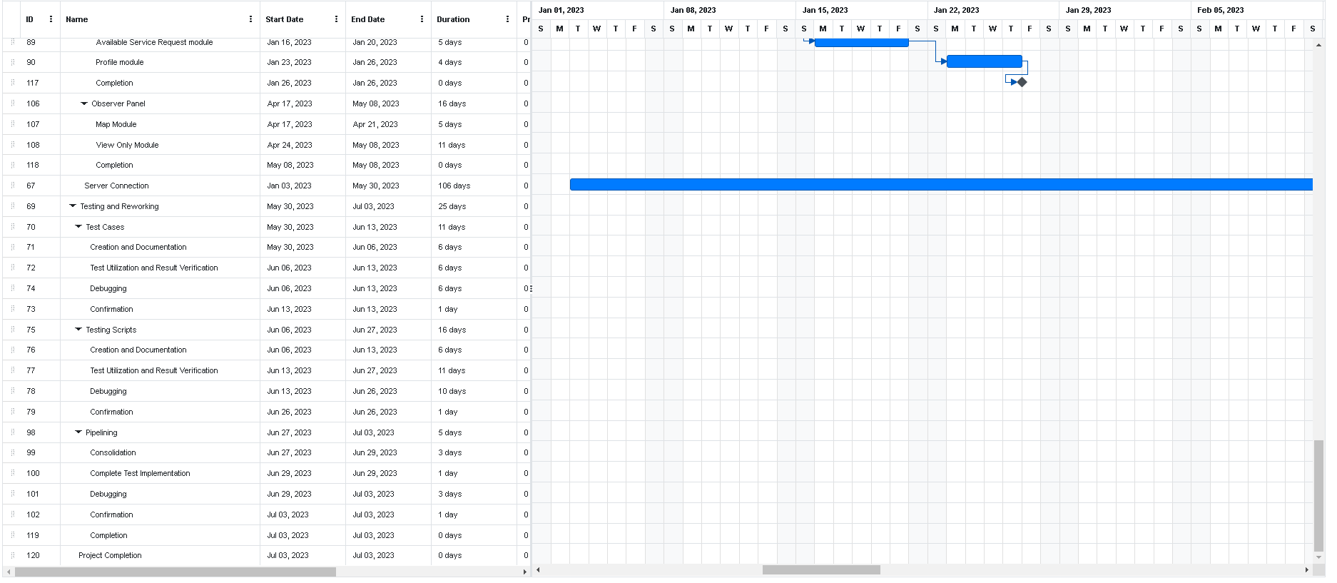
Project Plan
Gantt Chart

Slide 24
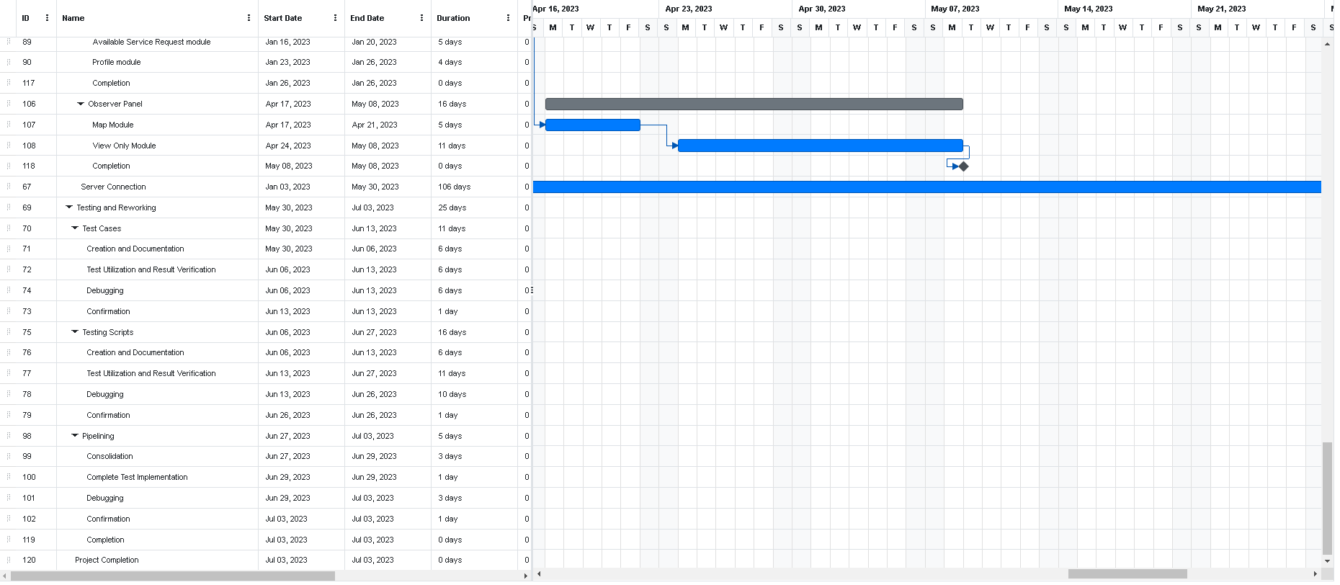
Project Plan
Gantt chart

Slide 25
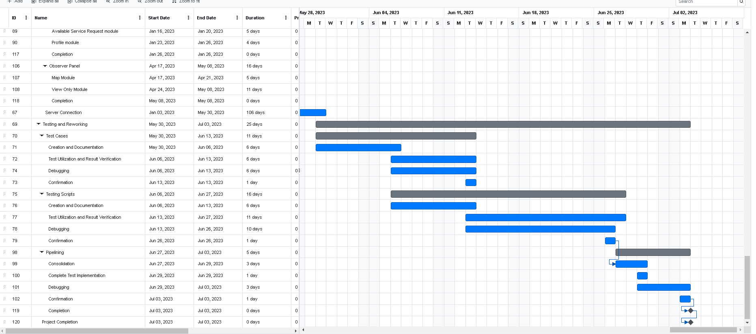
Project Plan
Gantt Chart

Slide 26
7- Budget / Costing
Estimated Budgeted Cost of the Project:
Development Cost:
Development | Time | Rate
Requirement | 100 Hours | Rs. 100,000
Architect | 50 Hours | Rs. 50,000
Coding | 150 Hours | Rs. 150,000
Testing | 50 Hours | Rs. 50,000
Total Cost Rs | = 350,000/-

Slide 27
7- Budget / Costing
Tool Cost:
Hardware Cost:
Tool | Cost
. MongoDB | 57$ = 12638 Rs / Month
. Play Store | 100$ = 24,000Rs
. Cloud . Third Party Api’s | 300$ = 66,300Rs 300$ = 66,300 Rs
Total Cost Rs | 179,238Rs /-
Hardware Tools | Cost
. Windows / Mac OS | 20,000Rs
. Laptop | 60,000Rs
. External Hard Drive | 10,000Rs
Total Cost Rs | 90,000Rs .. /-

Slide 28
7- Budget / Costing
Total Cost: Development +Tool + Hardware
Total Cost = 350,000Rs+ 179,238Rs + 90,000Rs
= 619,238Rs/-

Slide 29
8- Project Tools
Software Requirements:
VS Code
Android Studio
Insomnia
Git / GitBash
React JS
MongoDB
React Native
React Navigation
Node JS
Express JS
Hardware Requirements (if any):
Windows / Linux OS/ Mac OS

Slide 30
9- FYP Deliverables
Phase I - Alpha Prototype:
Product Proposal
Product Abstract
Product Schedule (Gantt Chart)
Documented Requirements

Slide 31
FYP-Deliverables
Phase II – beta Prototype
Structure
Data Base Design And Development
Customer Panel (UI/UX - GUI - ERD)
ERD
Design
Documentation
– Development (Front-end, Backend, Database)):
Login/ Signup
Messaging
Payment
Wallet
Price Negotiation feature
Map integration / Features
Service Categories
Bookings
Reviews
Notifications
Complains

Slide 32
FYP-Deliverables
Provider Panel:
– Development (Front-end, Backend, Database)):
ERD
Design
Documentation
Login / Signup
Messaging
Wallet
Price Negotiation
Map Integration
Request Leaguer
Accept / Reject / Overdue
Profile Management
History Of Booking Transactions

Slide 33
FYP-Deliverables
Phase III – Release Candidate
Structure
Database Design And Development
Customer Panel (UI/UX - GUI )
ERD
Design
Documentation
– Development (Front-end, Backend, Database)):
Login/ Signup
Messaging
Payment
Wallet
Price Negotiation feature
Map integration / Features
Service Categories
Bookings
Reviews
Notifications
Complains

Slide 34
FYP-Deliverables
Provider Panel:
Structure
Database Design and Development
Development (Front-end, Backend, Database)):
ERD
Design
Documentation
Login / Signup
Messaging
Wallet
Price Negotiation
Map Integration
Request Leaguer
Accept / Reject / Overdue
Profile Management
History Of Booking Transactions
Setting

Slide 35
FYP-Deliverables
Observer Panel
Development (Front-end, Backend, Database)):
ERD
Design
Documentation
View Only Mode
Map Integration
Global Map View
Login / Sign Up
Setting

Slide 36
FYP-Deliverables
Phase IV – Final Product
Structure
Database Design and Development
Customer Panel (UI/UX - GUI )
Design
Documentation
– Development (Front-end, Backend, Database)):
Login/ Signup
Messaging
Payment
Wallet
Price Negotiation feature
Map integration / Features
Service Categories
Bookings
Reviews
Notifications
Complains
Setting

Slide 37
FYP-Deliverables
Provider Panel:
– Development (Front-end, Backend, Database)):
Design
Documentation
Login / Signup
Messaging
Wallet
Price Negotiation
Map Integration
Request Leaguer
Accept / Reject / Overdue
Profile Management
History Of Booking Transactions
Setting

Slide 38
FYP-Deliverables
Observer Panel
Database Design and Development
– Development (Front-end, Backend, Database)):
Design
Documentation
View Only Mode
Map Integration
Global Map View
Login / Sign Up
Setting

Slide 39
FYP-Deliverables
Admin Panel
Database Design and Development
– Development (Front-end, Backend, Database)):
Design
Documentation
Login / Signup
Dashboard
Reviews
Complete / Schedule Requests
Cancellations / Reasons
Map View
User’s List
Service Provider’s List
Partner’s
Service Type (Crud Operation)
Payments
Setting
Testing:
Test Cases
Test Scripts
Pipelining

Slide 40
10- Reference
Domestic Android Application for Home Services (researchgate.net)
Android Application on Domestic Services-eSeva
Development of App to Provide Blue Collar Services to the Public

Slide 41
THANK YOU!

